Slide 1

COVID19 in the US
By:

Slide 2
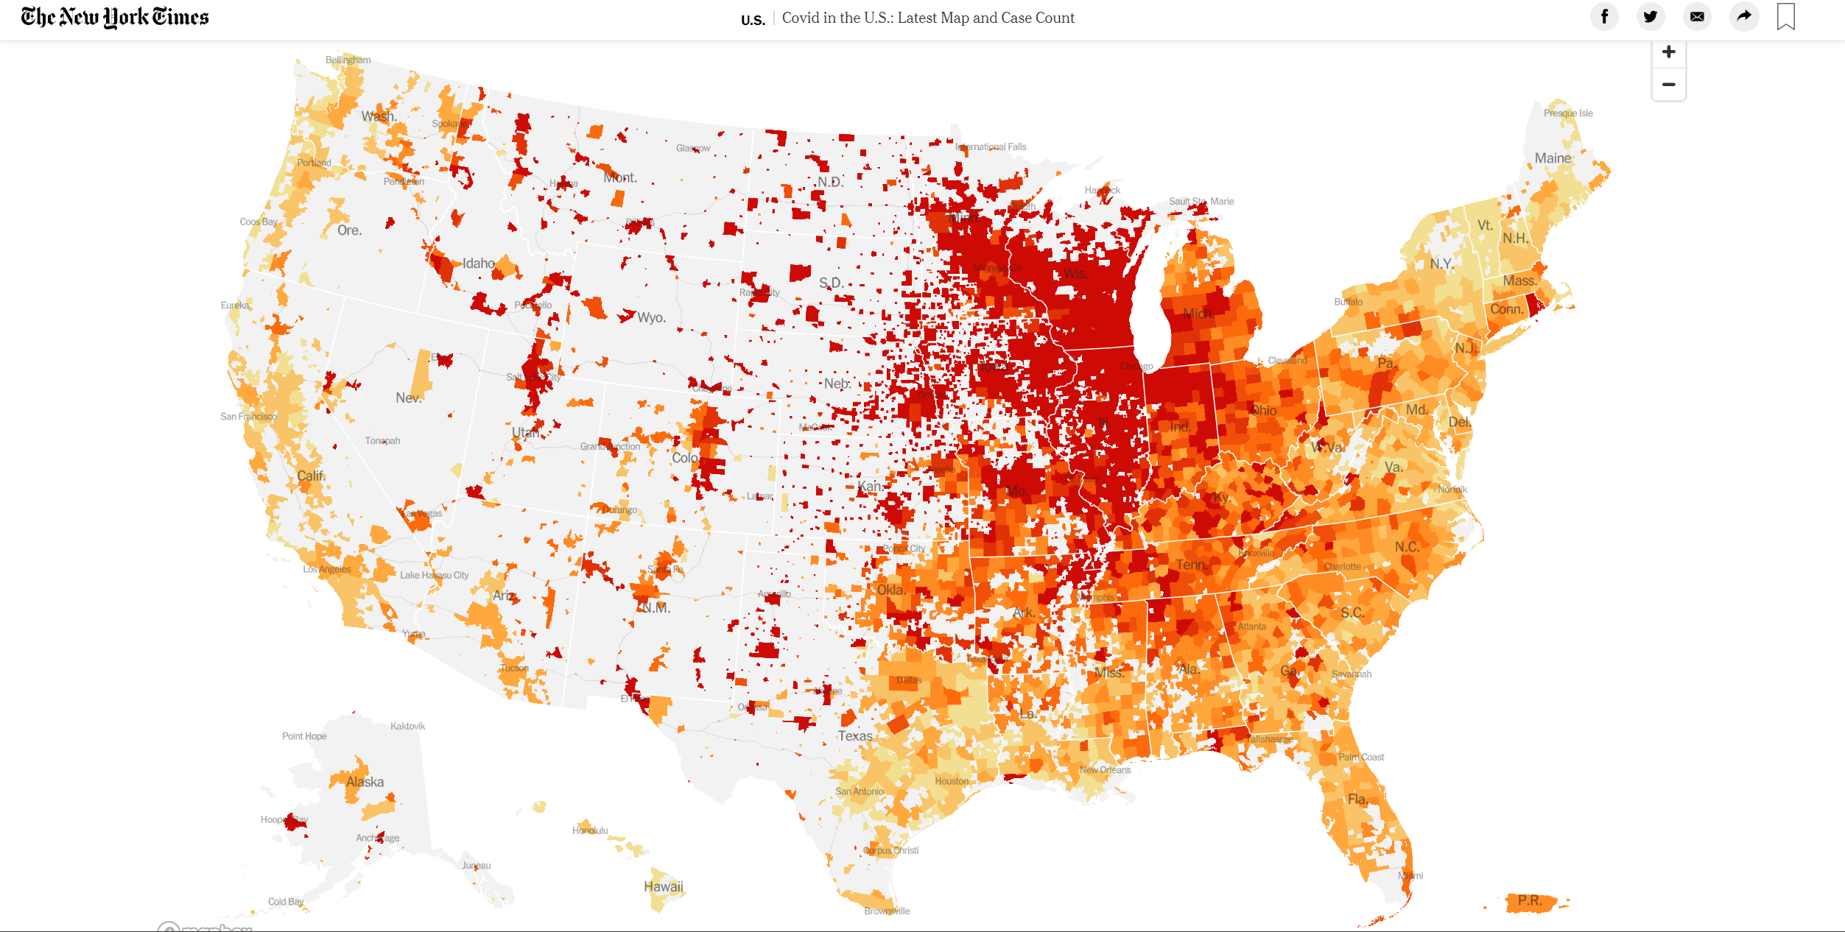

Slide 3


Do rates of covid19 differ based on local policies implemented?
Comparison between California and Texas

Slide 4
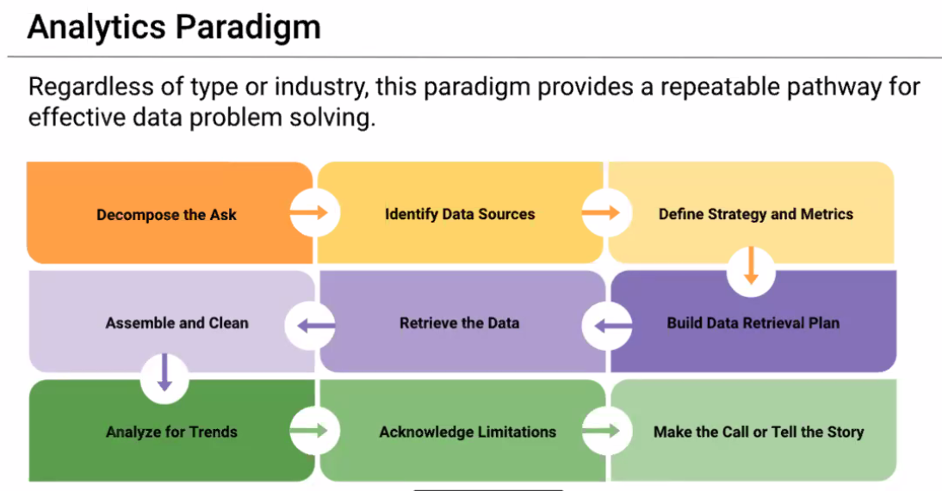

Slide 5
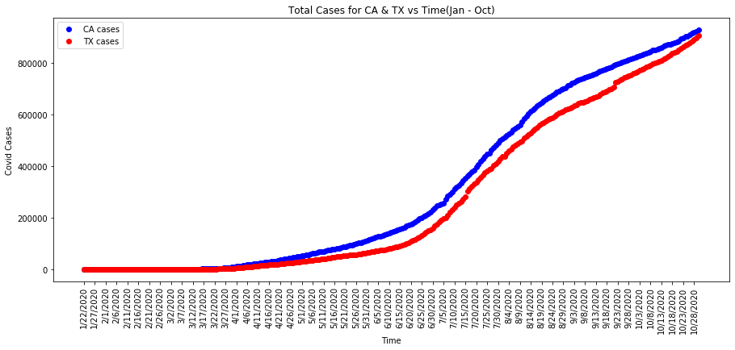

Slide 6
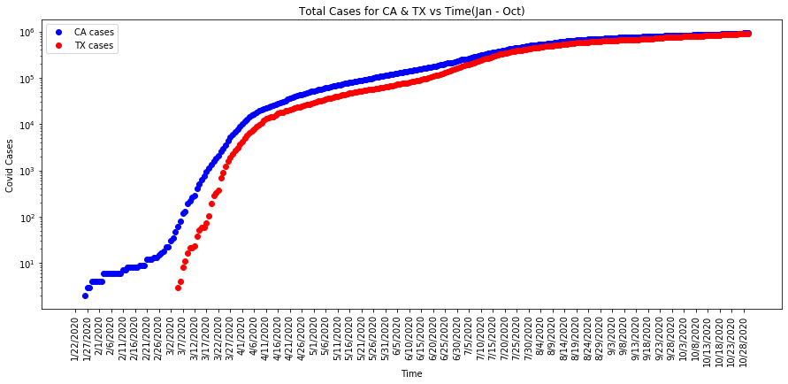

Slide 7
Resources
John Hopkins University Covid19 data
NY Times
CA and TX Health Government websites (policy implementation)

Slide 8
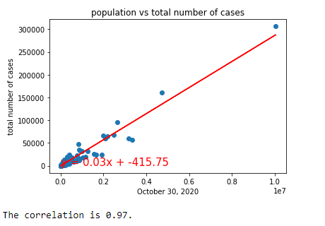
Exploratory data visualization
CA and TX population plotted together against cumulative Covid19 cases by 10/30/2020

Slide 9
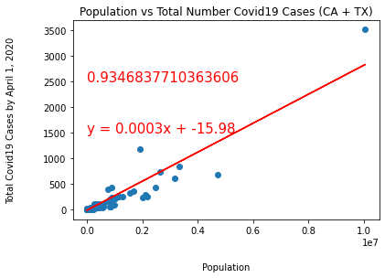
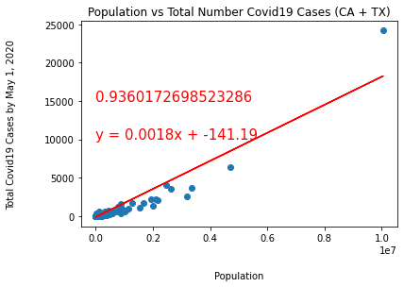
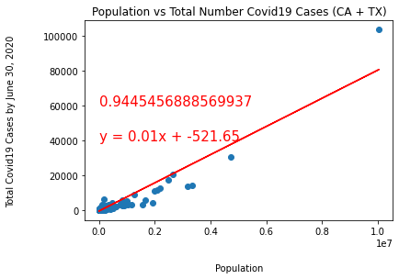
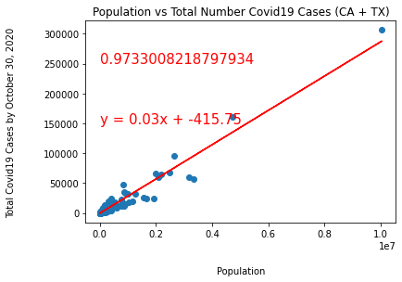
CA and TX population plotted together against cumulative Covid19 cases by Dates
April 1,2020
May 1,2020
June 30,2020
October 30,2020

Slide 10
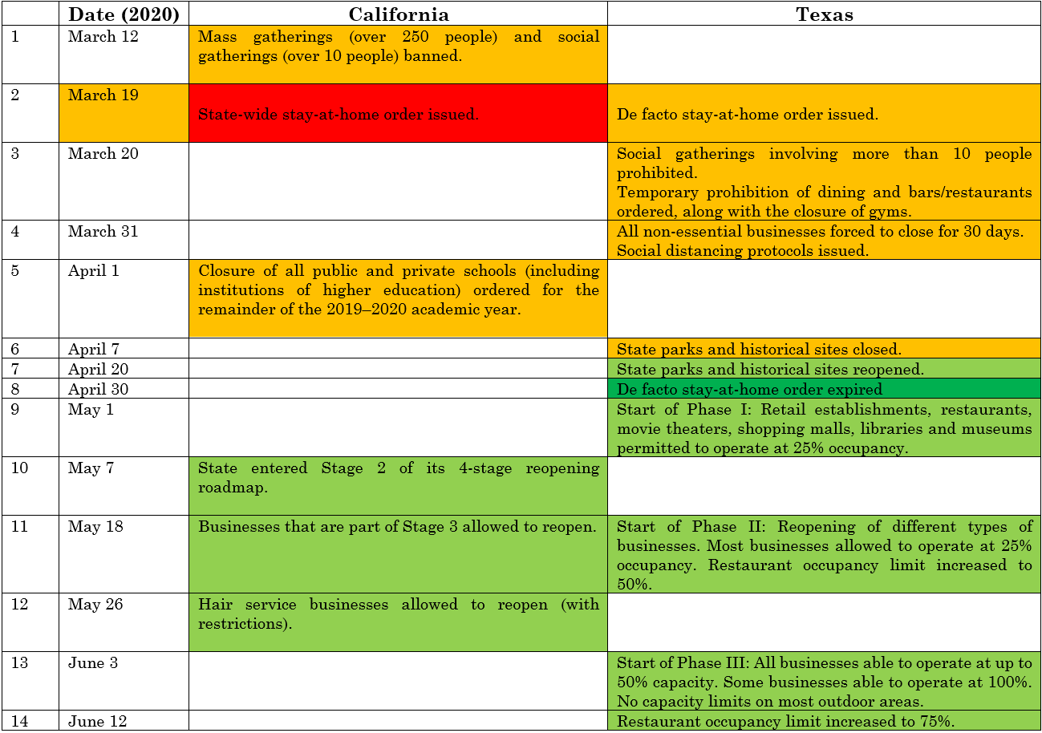

Slide 11
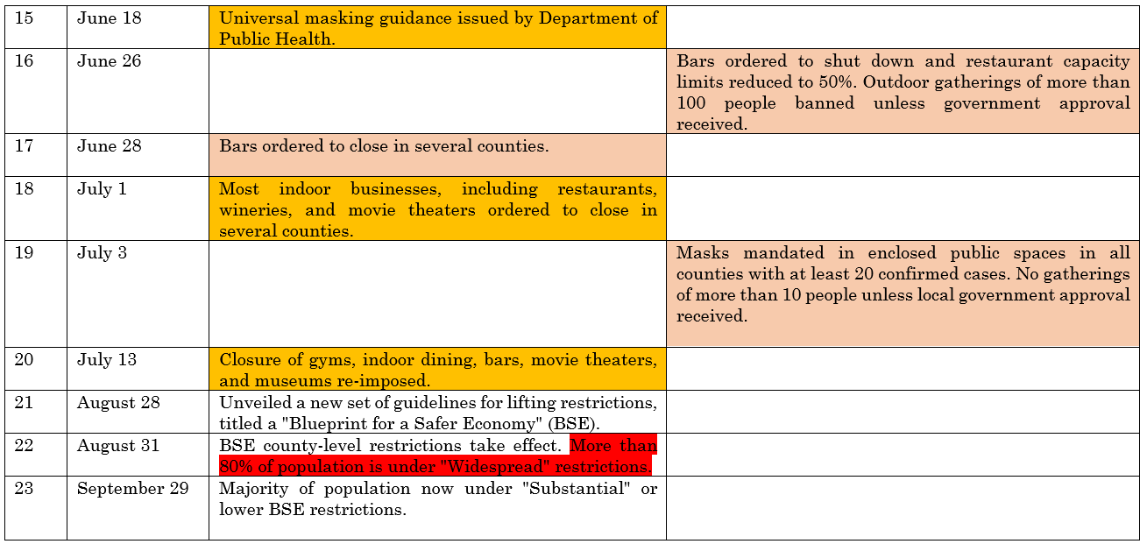

Slide 12
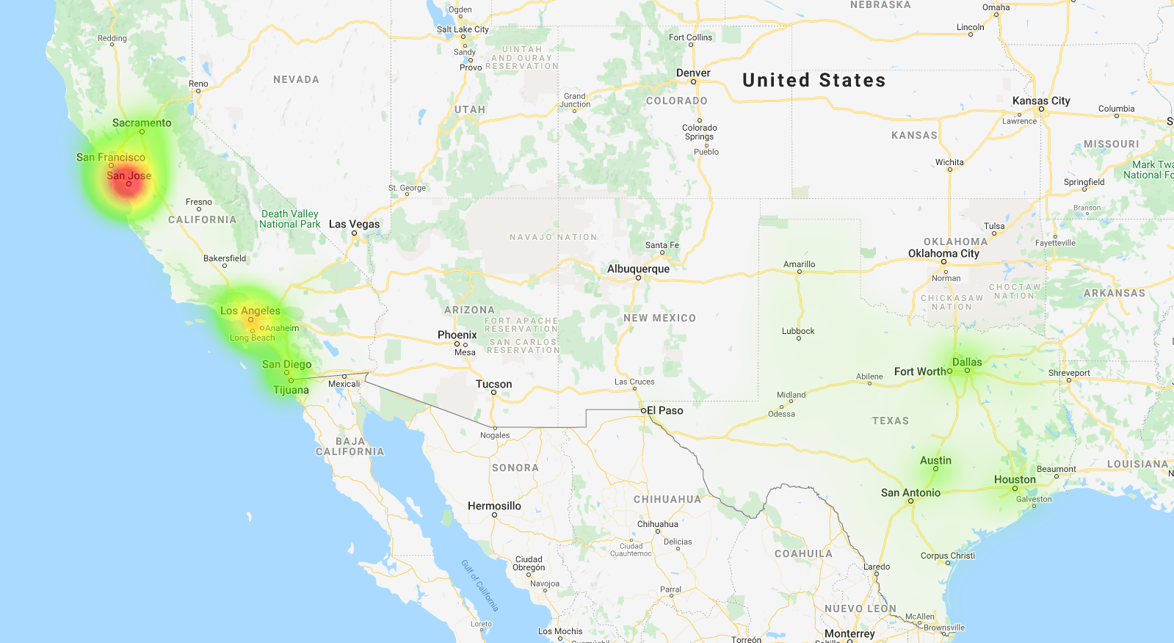

March 18, 2020

Slide 13
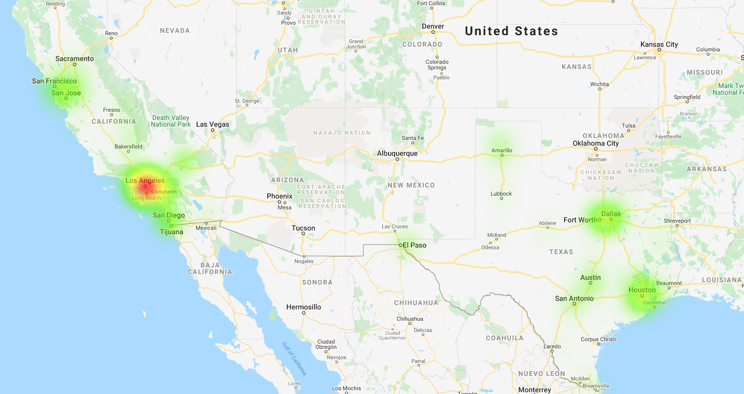
April 29, 2020

Slide 14
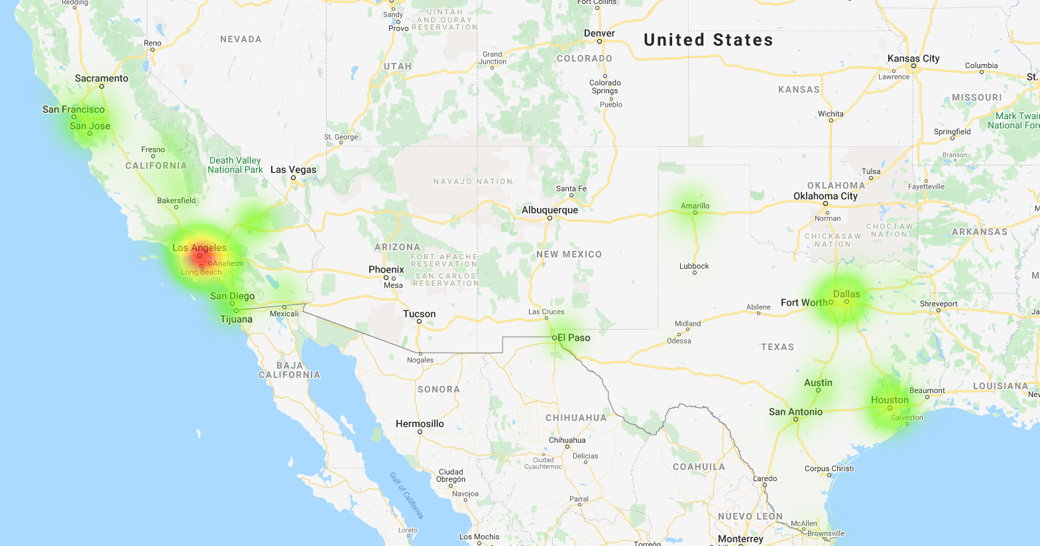
May 27, 2020

Slide 15
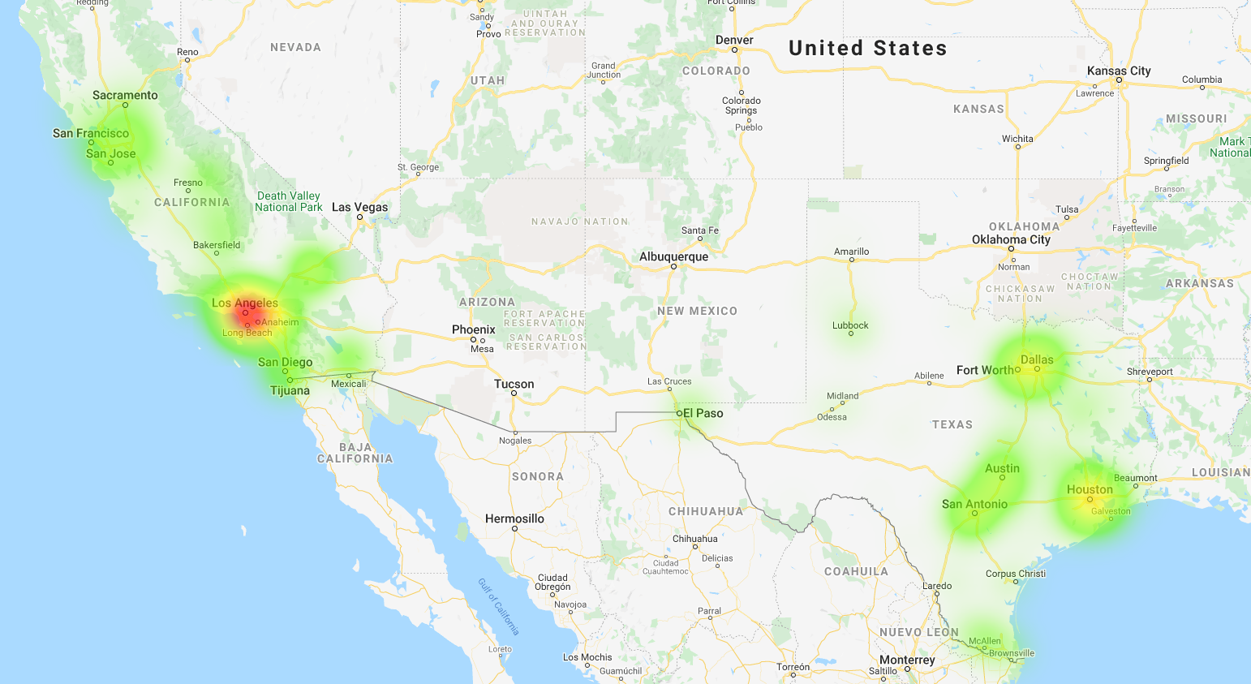
June 24, 2020

Slide 16
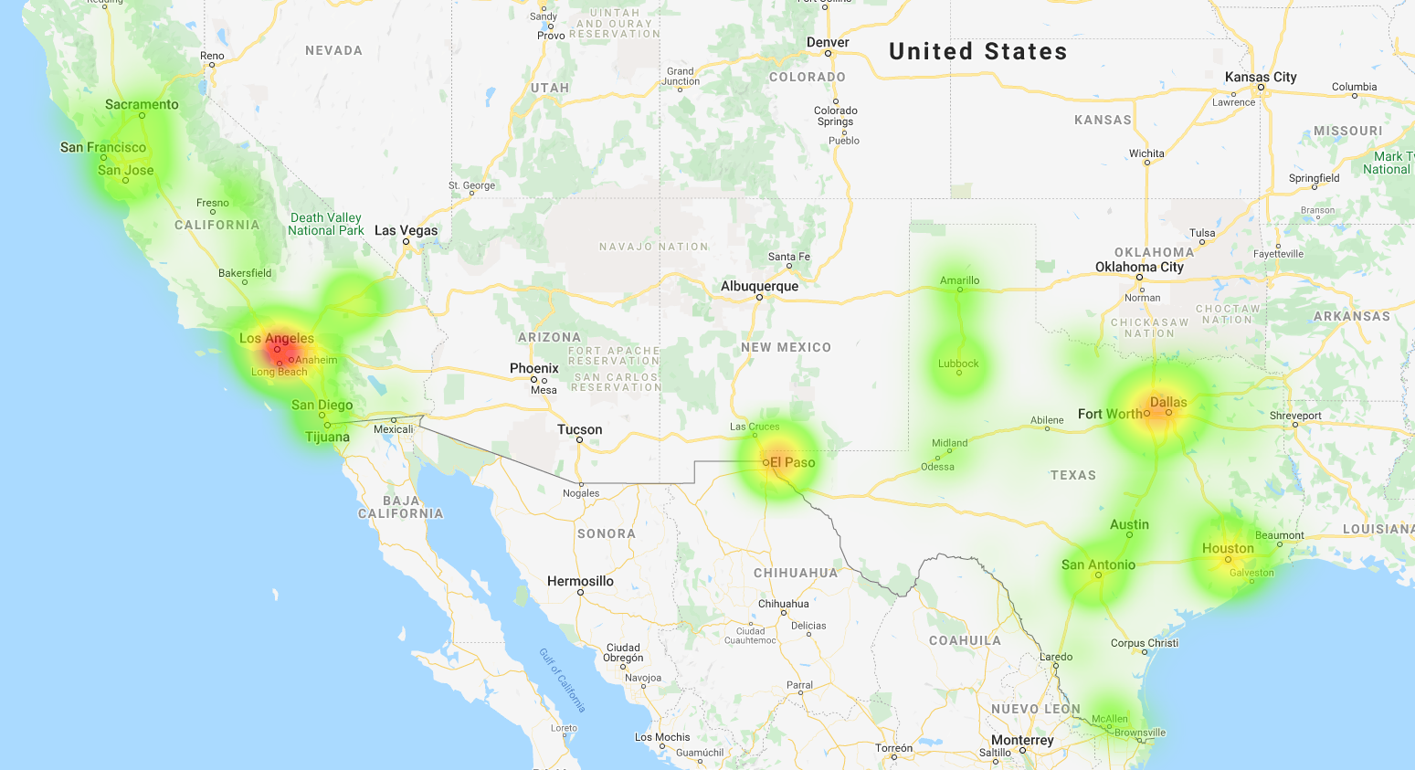
October 28, 2020

Slide 17
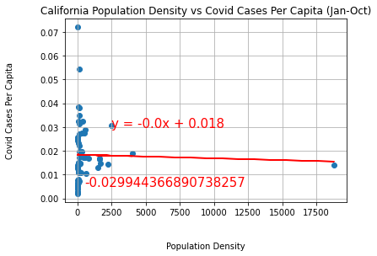
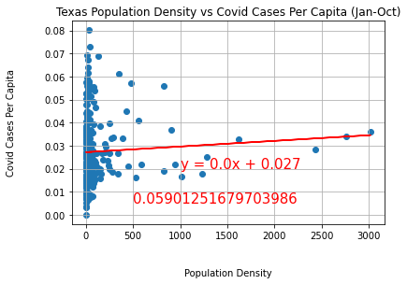
State | Population | Difference in Population | Land Area(Sq. Mi.) | Difference in Land Area | Population Density
CA | 37,332,138 | CA 8.3 million more | 155,779 | TX 105K Sq. Mi. more | 0.0042
TX | 28,995,881 |  | 261,267 |  | 0.009
San Francisco

Slide 18
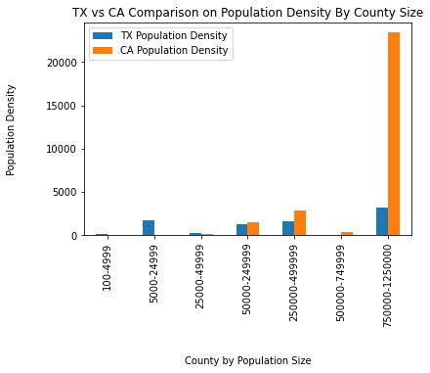
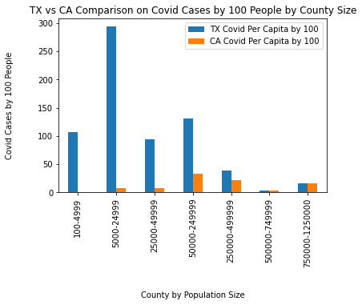
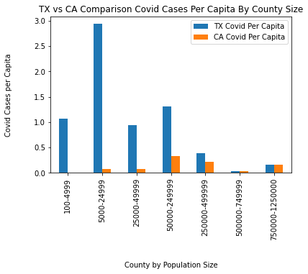
Counties by Population Size
Rural
Urban
Rural
Urban

Slide 19
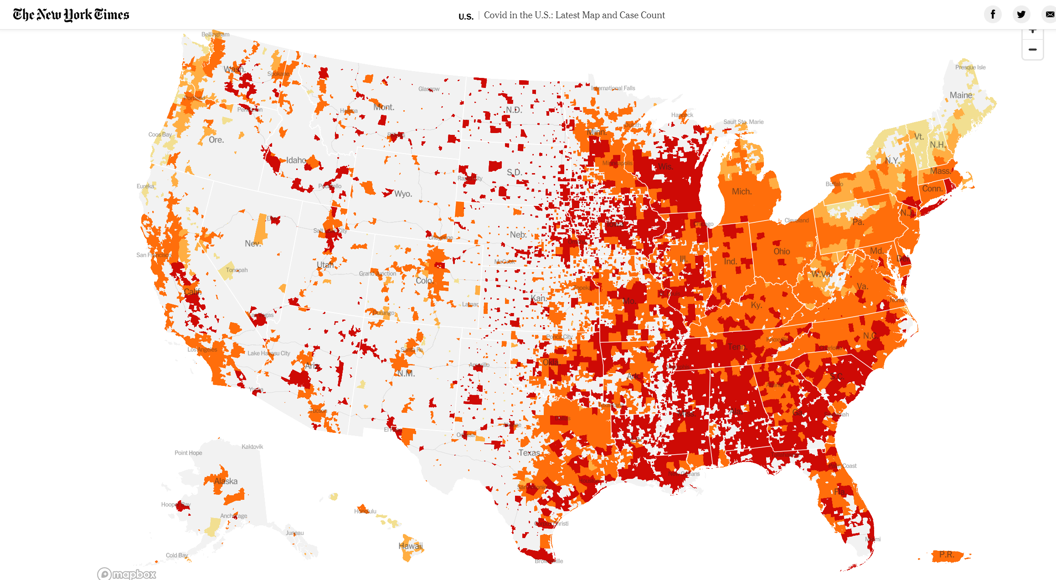
Codic19 Cases Per Capita, 11/8/2020

Slide 20
Limitations

Slide 21
Things we would do different next time

